Slide 1

Exploratory Data Analysis Report
Institute of ICT Professionals(IIPGH), Ghana
MARJESSNATE
30th of September 2023

Slide 2

Table Of Contents
Acknowledgement
The Project
Introduction
Profile Of Company and Client
Analysis
Findings
Recommendations
Conclusion

Slide 3
ACKNOWLEDGEMENTS
IIPGH: Grateful for their dataset and support.
Miss Barbara Asiamah: Guided us with expertise.
Supporters: Thanks for your contributions.

Slide 4
INTRODUCTION
This project involves an Exploratory Data Analysis (EDA) of data from students of the Institute of ICT Professionals Ghana (IIPGH).
Objective: To gain insights and make data-driven recommendations for IIPGH.
One of the recommendations includes the creation of a prototype enabling students to access their information, achievements, and projects.

Slide 5
Profile of Marjessnate
MARJESSNATE: A company providing IT solutions, including data analytics and graphic design.
Established in 2023.
Founders: Marvellous Isijola, Jessica Adzah, Nathan Opata.

Slide 6
Profile of IIPGH
Institute of ICT Professionals, Ghana(IIPGH) is a professional association made up of experts in various fields of Information and Communication Technology(ICT).
IIPGH’s mission is to become the most reliable partner in ICT development in Ghana and beyond.
Its divisions are Academy, Domain Leadership, Professional Service, and Foundation.

Slide 7
Data Source
The data was collected through a specially designed form sent to IIPGH students. The message accompanying the form was as follows:
Hello All,
We're IIPGH students learning about data analytics, and we've created a special form called the IIPGH Student Info Form. This form is a crucial part of our project, where we're going to study and share the data we collect.We kindly request all IIPGH students to complete it, and we ask the tutors to assist in ensuring that their students fill out the form.
We would really appreciate your help in making our project successful. Please take a moment to fill out this form.
📝 You can access the form here:
https://bit.ly/IIPGH-SF
Thank you so much for your support.
Best regards,
IIPGH Students in the Data Analytics Module

Slide 8
TOOLS USED
Google Colab: Used in the writing of code used to analyze the data.
Google Docs: Used in the creation of the report.
Google Sheets: Used in cleaning, storing, and managing the data.
Google Slides: Used in creating the presentation that serves as the summary of the report.
Snipping Tool: Used in taking screenshots of the graphs plotted.

Slide 9
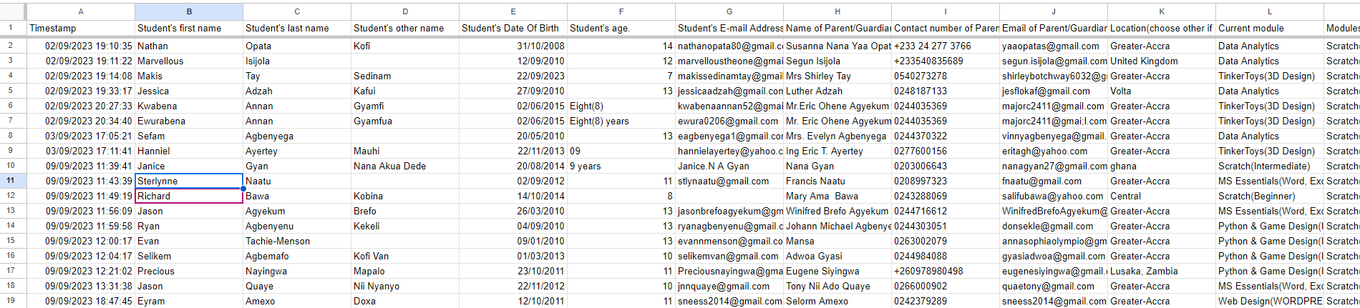
Understanding the Data
The data contains answers to the 19 questions that were put to the students to answer. They required answers like the student’s names, email, completed modules, current module, satisfaction levels etc.

Slide 10
Data Cleaning
DOB: The first few entries were scrutinized in order to confirm their authenticity.
Age: 11 entries in the Age column were text based so they were changed to integers as the Age column is a numeric column.
Location: 1 person chose to write ghana and not pick an exact location so it was manually changed to Greater-Accra.

Slide 11
ANALYSIS

Slide 12
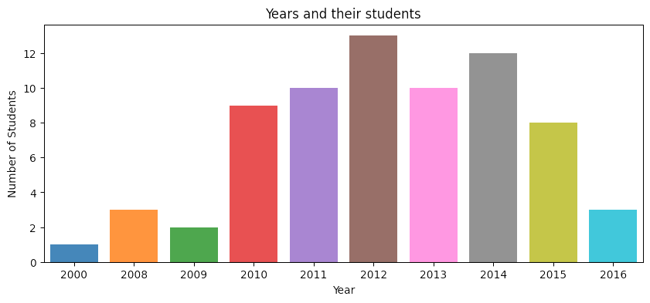
DOB ANALYSIS
2012 is the most common Birth Year as according to our analysis, over 12 students are born in that year alone.

Slide 13
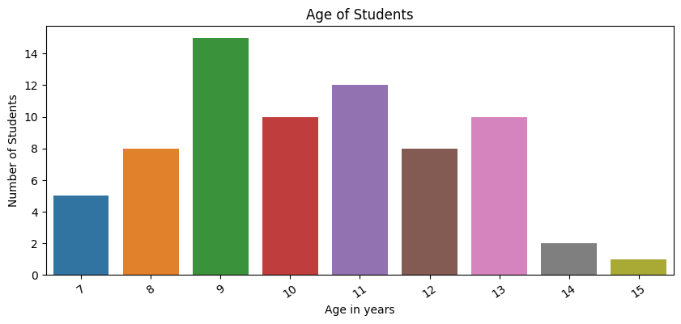
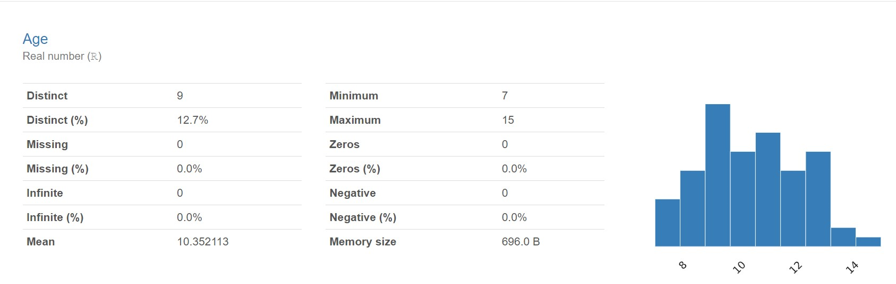
AGE ANALYSIS

Slide 14
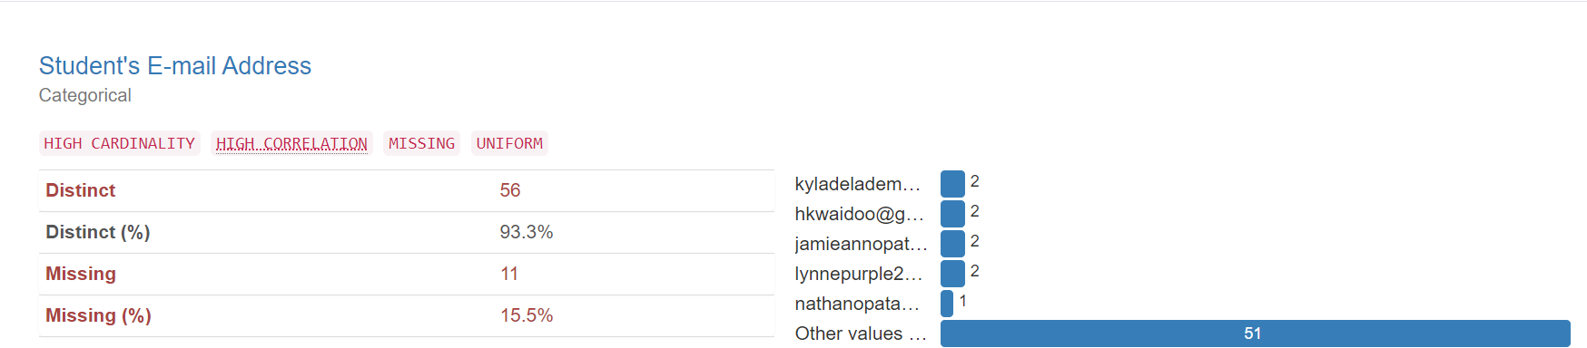
E-mail Address

Slide 15
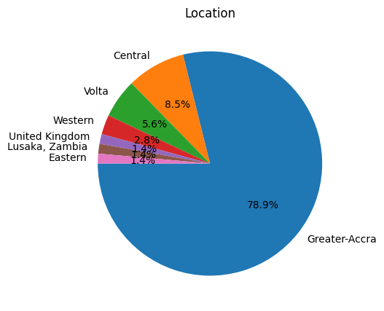
Location

Slide 16
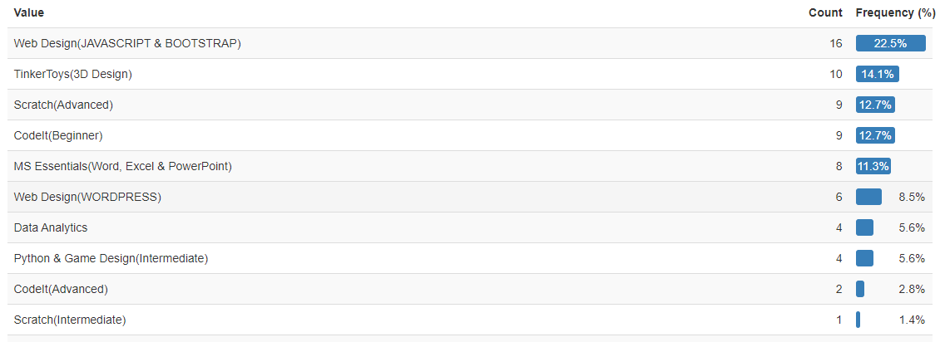
Current Module

Slide 17
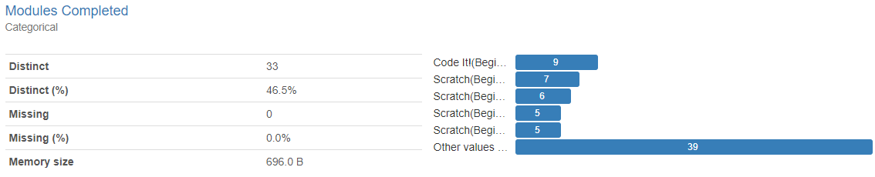
Modules Completed

Slide 18
Recommend

Slide 19
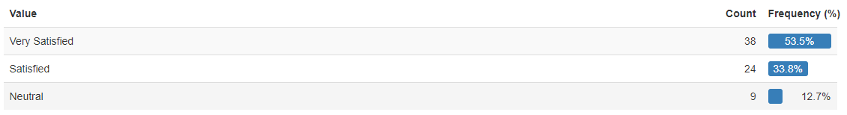
Satisfaction

Slide 20
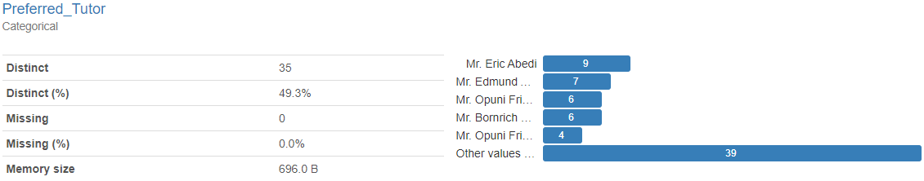
Preferred Tutor

Slide 21
FINDINGS

Slide 22
Findings
The years between 2010 and 2015 had the most students born in them.
The students who filled out the form were between the ages of 7 and 15
15.49% of the students who filled out the form did not have emails.
WEB DESIGN(JAVASCRIPT AND BOOTSTRAP) was being done by more students while Scratch(Intermediate) was the least common module among students.
Students when filling the form thought that scratch, code it, and app inventor needed improvement.

Slide 23
Findings(Cont’d)
Most of the people who filled out the form said they would recommend IIPGH to others but the other few said the opposite.
Greater Accra had most of the students living there whiles the United Kingdom, Zambia and the Eastern Region of Ghana had the least amount of students living there.

Slide 24
RECOMMENDATIONS

Slide 25
Recommendations
You should consider the following:
Expanding your course offerings to include topics like animation, software programming, robotics, AI, and more.
Making sure that the projects and assignments are designed to reinforce the concepts covered in the modules.
Helping students with time management strategies to better handle their coursework alongside other responsibilities like school.

Slide 26
Recommendations(Cont’d)
Marjessnate would also recommend that you have a web app prepared. It should have the following features:
A Home page
An About Us Page
A Student Information Page
A Student Projects Page

Slide 27
Conclusion
In this presentation, we have explored the analysis of the data from the form conducted by our company. We have seen that the report provides valuable insights into the student’s’ preferences, expectations, and feedback on IIPGH’s services. We have also learned how to use various statistical tools and techniques to interpret and visualize the data in a meaningful way.

